Slide 1
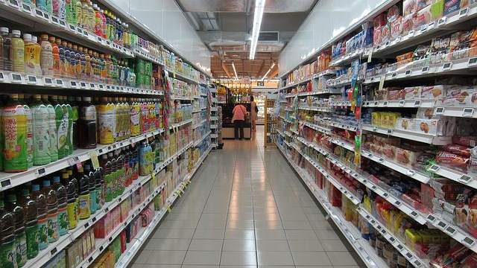
Capstone presentation
Sivamurugesh Arumugam
(for IBM Professional Certificate from Coursera)

Slide 2
Business problem
Foodie culture requires good department store
Huge middle-class population and good location, find a place in South and East Chennai
City centers already have many stores
Costly goods in city center locality
Demand is more here and profit for stakeholders

Slide 3
Data analysis
https://en.wikipedia.org/wiki/List_of_neighbourhoods_of_Chennai
Data from the required table taken
Cleanup was done for proper visualization
Folium and FOURSQUARE API’s used for map
SKLEARN used to do k-means clustering

Slide 4
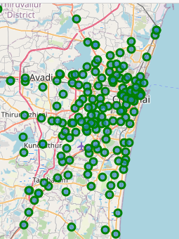
Foursquare api
Source of information about venues and neighbourhoods
Map based API to get details
Folium package used for map
Color code and dots with data

Slide 5
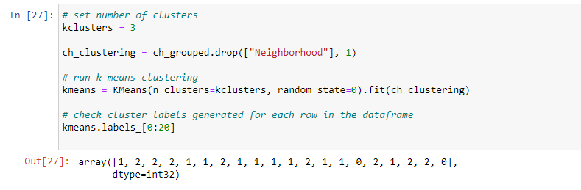
K-means clustering
With 3 for value of k
Labels were added
Data applied shows array
Map shown in next slide
SKLEARN package used

Slide 6
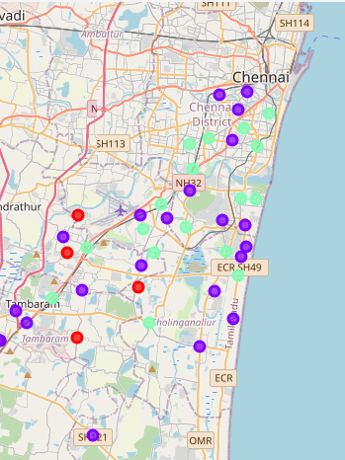
K-means clustering (2)
k-means clustering on data applied
Map from folium for the neighborhood
Different colors showing different clusters
Red is cluster 0 showing 4 places
Minimum available stores across clusters is red

Slide 7
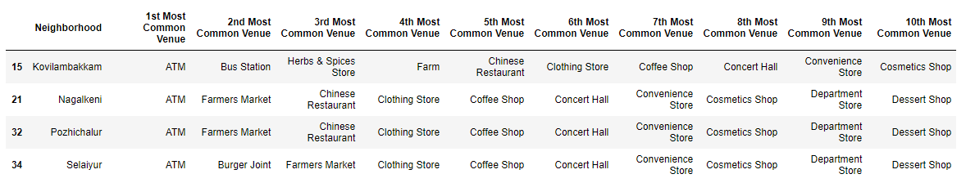
Result showing 4 places for a department store

Slide 8

Thank you

